Slide 1

Chapter 5
Introduction
To
Data-Link
Layer
Copyright © The McGraw-Hill Companies, Inc. Permission required for reproduction or display.

Slide 2
Chapter 5: Outline
INTRODUCTION
LINK-LAYER ADDRESSING
Notes:
9.#

Slide 3
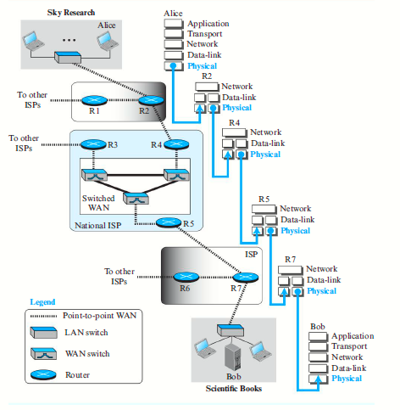
9.<number>

Slide 4

Chapter 5: Objective
The first section introduces the data-link layer. It starts with defining the concept of links and nodes. The section then lists and briefly describes the services provided by the data-link layer. It next defines two categories of links: point-to-point and broadcast links. The section finally defines two sub-layers at the data-link layer that will be elaborated on in the next few chapters.
Notes:
9.#

Slide 5
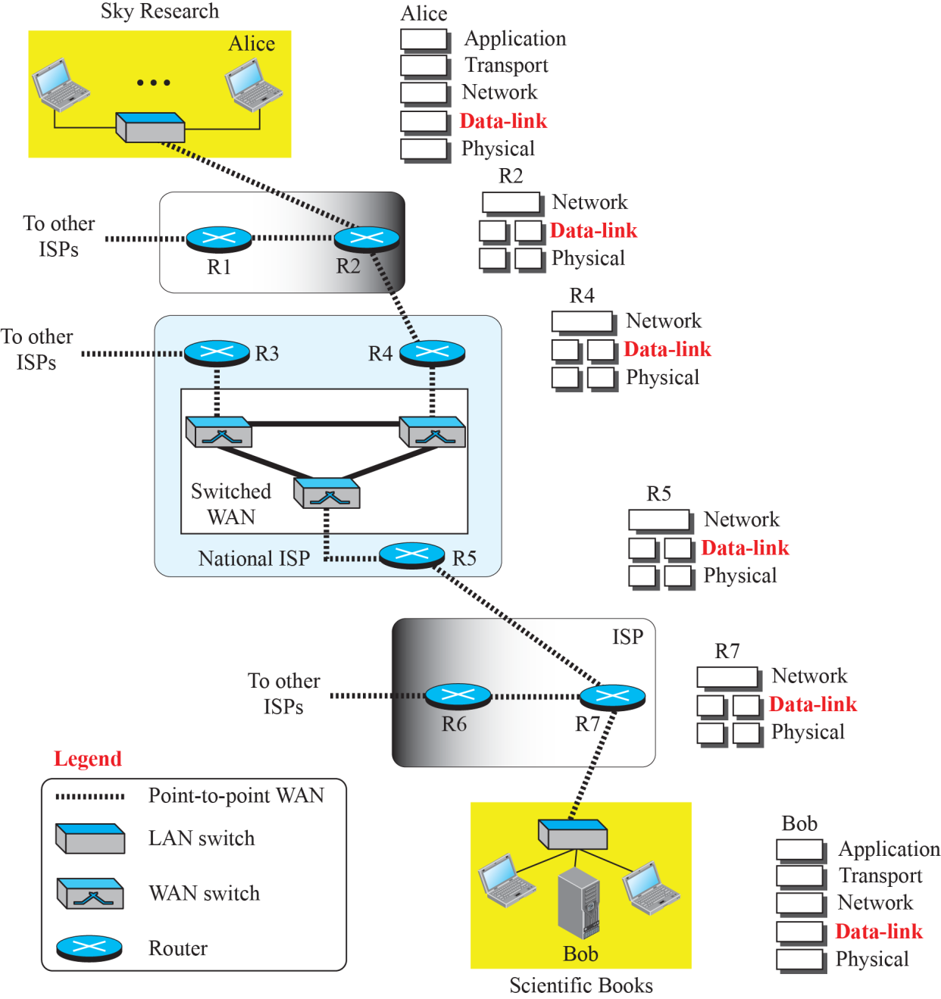
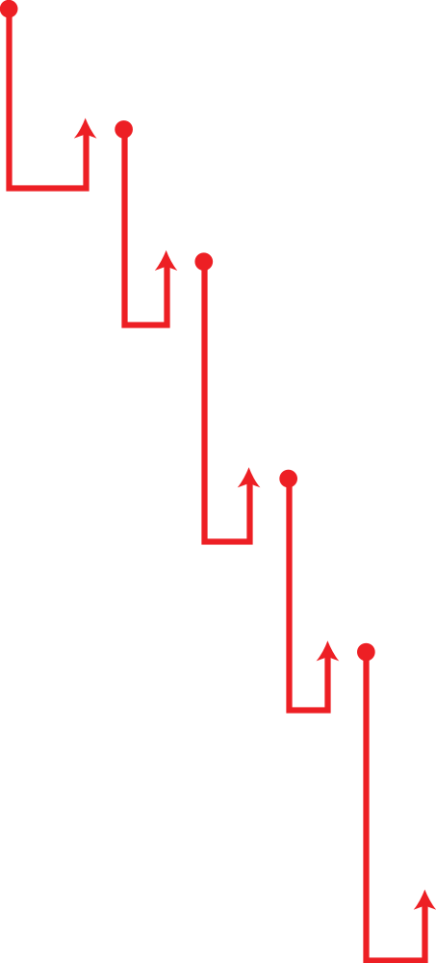
Communication at the data-link layer
9.<number>
Notes:
9.#

Slide 6
Nodes and Links
Communication at the data-link layer is node-to-node.
A data unit from one point in the Internet needs to pass through many networks (LANs and WANs) to reach another point.
Theses LANs and WANs are connected by routers.
A simple representation of links and nodes when the path of the data unit is only six nodes.
9.<number>
Notes:
9.#

Slide 7
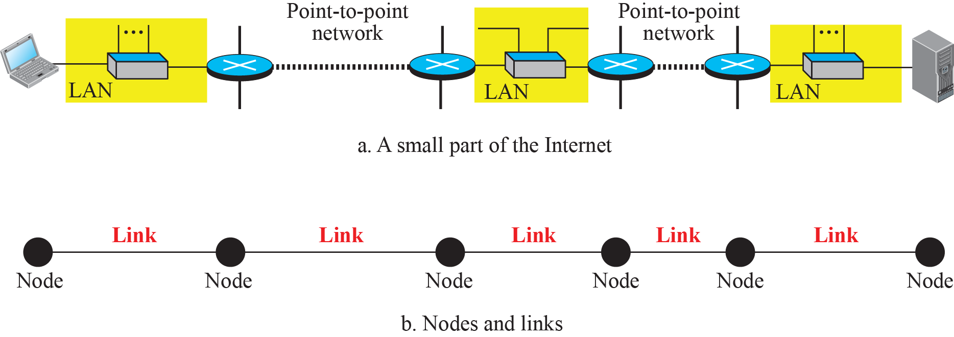
Nodes and Links
9.<number>
Notes:
9.#

Slide 8
Services
The data-link layer is located between the physical and the network layers.
The data-link layer provides services to the network layer; it receives services from the physical layer.
9.<number>
Notes:
9.#

Slide 9
Types of links
Data Link Layer controls how the medium is used.
Two types:
Point to point Link: Dedicated between a pair of devices.
  Local Telephone
Broadcast Link: Shared between several pairs of devices.
  Cellular phone
9.<number>

Slide 10
9.9.4 Two Sublayers
The data-link layer is divided into two sub-layers:
Data link control (DLC)
Media access control (MAC).
9.<number>
Notes:
9.#

Slide 11
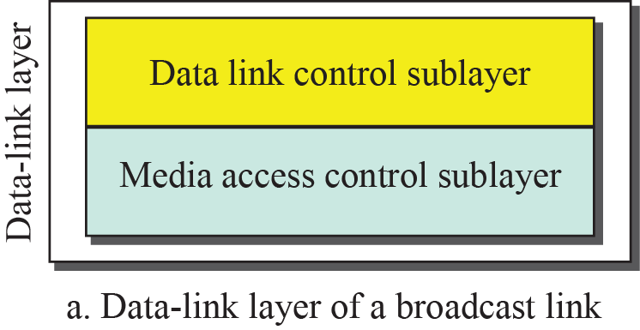
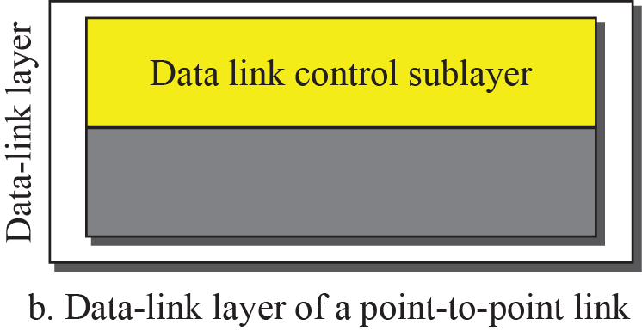
Dividing the data-link layer into two sub-layers
Notes:
9.#

Slide 12
DLL IS DIVIDED INTO DLC AND MAC
DLC- DATA LINK CONTROL:
  FRAMING
  FLOW CONTROL
  ERROR CONTROL
  ERROR DETECTION AND CORRECTION
9.<number>

Slide 13
FRAMING- PACK BITS INTO FRAMES
1110001-----10101000 ---- 10111010---- 10101010--- 10101011 ---- 11111
DESTINATION
SOURCE
FRAME SIZE –FIXED AND VARIABLE
  CHARACTER ORIENTED FRAMING - BYTE
  BIT ORIENTED FRAMING
9.<number>

Slide 14
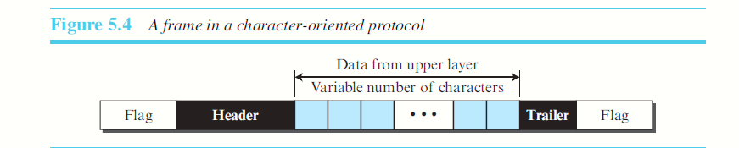
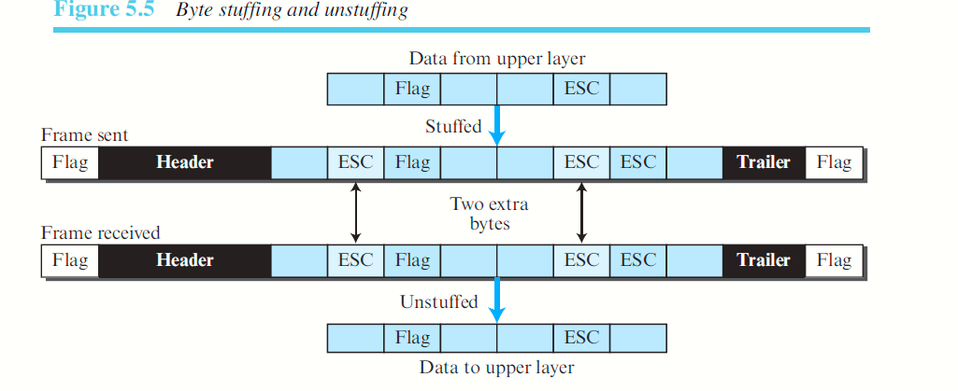

Slide 15
Byte stuffing is the process of adding one extra byte whenever there is a flag or escape character in the text.

Slide 16
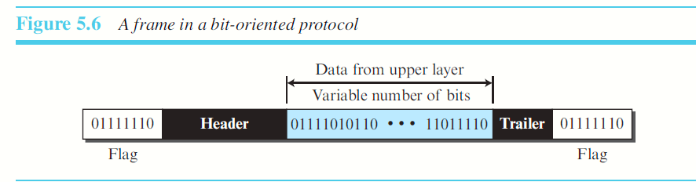
Bit stuffing is the process of adding one extra 0 whenever five consecutive 1s follow a 0 in the data, so that the receiver does not mistake the pattern 0111110 for a flag.

Slide 17
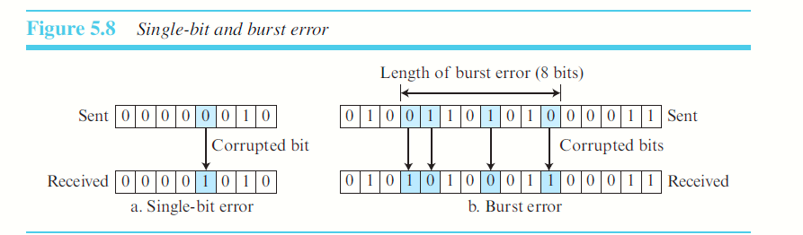
ERROR CONTROL:
  ERROR DETECTION 11110000 11110000 10110000 – RETRANSMIT
  ERROR CORRECTION 11110000 10000000 - 11110000
TYPES OF ERRORS: (CAUSED DUE TO INTERFERENCE)
  SINGLE BIT ERROR
  BURST ERROR
9.<number>

Slide 18
HOW IS ERROR DETECTED???
REDUNDANCY – ADDING EXTRA BITS TO THE DATA.
  ADDED BY THE SENDER AND REMOVED BY THE RECEIVER.
  1001 – EVEN OR ODD – FIRST BIT WILL SPECIFY NUMBER OF 1s IN THE DATA- 1 EVEN 0- ODD 1s
  11001 - 11001 – 11101 – 10101 - 01001
ERROR DETECTION – DEALS WITH FINDING THE OCCURRENCE OF ERROR/ERRORS.
ERROR CORRECTION – DEALS WITH DETECTING ERRORS AND CORRECTING IT?
  DIFFICULTY IS IN FINDING THE LOCATION?
IF THERE ARE 8 BITS DATA, AND THE RECEIVER WANTS TO CORRECT ERRORS IN 2 LOCATIONS, HOW MANY POSSIBILE ERROR LOCATIONS HAVE TO BE FOUND?
N!/(N-R)!.R!= 8*7/2=56/2=28.
9.<number>

Slide 19
HOW IS REDUNDANCY ACHIEVED?
  THROUGH VARIOUS CODING SCHEMES.
  Two schemes are:
  Block Coding and Convolution coding
  Block Coding: 11101110 11 10 11 10 = K=2
  Message is divided into blocks of ‘k’ bits each – Datawords.
  The redundant ‘r’ bits are added to each block. 11r 10r 11r 10r r=1 2 power 3 =8
  The resultant block has ‘n’ bits i.e. n=k+r. – Codewords.
  Combination of Datawords is 2^{k} and Codewords is 2^{n.}
  Codewords>datawords.
9.<number>

Slide 20
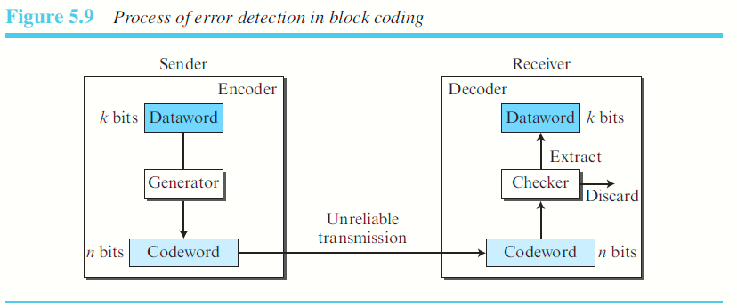
How can errors be detected using Block Coding??
  Two conditions:
    The receiver has (or can find) a list of valid codewords.
    The original codeword has changed to an invalid one.
9.<number>

Slide 21
Let us assume that k = 2 and n = 3.The list of datawords and codewords. N=k+r -→ 2 , r=1
01 → 011------------------------ 011-→ 01 - accepted
01→ 011 ----------------------- 010 → discarded
01 -> 011------------------------ 111 → discarded
01 -> 011 ----------------------- 001 → discarded
01 -> 011 ------------------------- 101 → accepted – incorrect
01 -> 011 ---------------- 100 → discarded
01 → 01--------------------- 01 ->good
10 -> 101 ---------------------- 101 – accepted
10-> 101 --------------------- 001 – unaccepted
10 -> 101 --------------------- 100 unaccepted
10 -> 101 ---------------------- 010 – not accepted
- 101
An error-detecting code can detect only the types of errors for which it is designed; other types of errors may remain undetected.
DATAWORD | CODEWORD | DATAWORD | CODEWORD
00 | 000 | 10 | 101
01 | 011 | 11 | 110
9.<number>

Slide 22
Hamming Distance
  is the number of differences between the corresponding bits.
    d(00000, 01101) = 3
    XOR.
    Accept two codewords – XOR –
    00000 01100
    01101 01101
    --------- -------------
    01101 – 3 00001 - 1
9.<number>

Slide 23
MINIMUM HAMMING DISTANCE
Smallest distance between all the possible pairs of codewords given.
dmin= s+1
S=3
Dmin=4 s+1 = s=2
To guarantee the detection of up to s errors in all cases, the minimum Hamming distance in a block code must be dmin = s + 1.
9.<number>

Slide 24
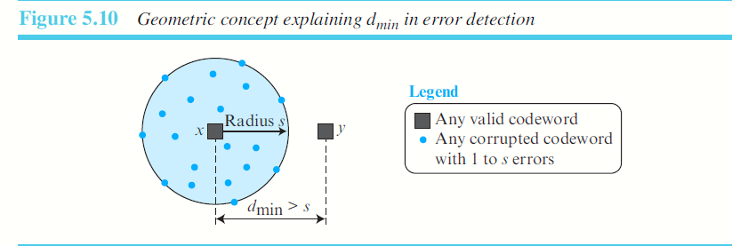
9.<number>

Slide 25
All block codes used today belong to a subset of block codes called linear block codes.
A linear block code is a code in which the exclusive OR (addition modulo-2) of two valid codewords creates another valid codeword
Minimum Distance for Linear Block Codes
The minimum Hamming distance is the number of 1s in the nonzero valid codeword with the smallest number of 1s.
9.<number>

Slide 26
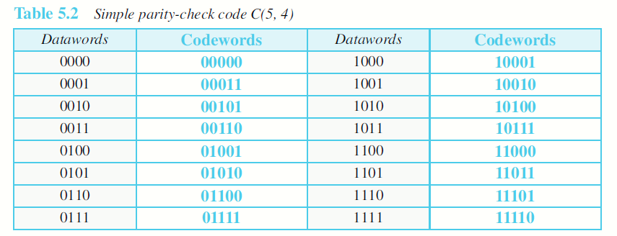
Parity-Check Code: In this code, a k-bit dataword is changed to an n-bit codeword where n = k + 1.
The extra bit, called the parity bit, is selected to make the total number of 1s in the codeword even.
0100 -> 1 – 01001
1110 -> 1 - 11101

Slide 27
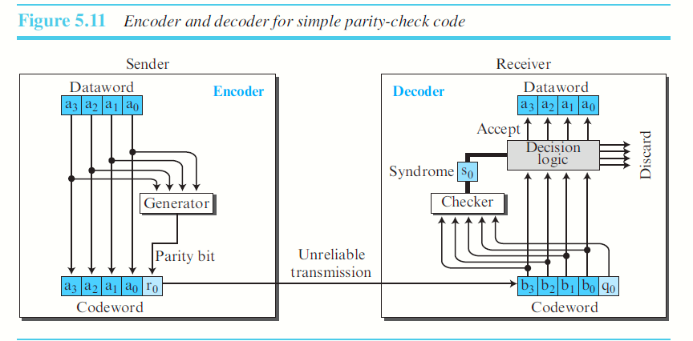

Slide 28
Sender:
The encoder uses a generator that takes a copy of a 4-bit dataword (a0, a1, a2, and a3) and generates a parity bit r0
The dataword bits and the parity bit create the 5-bit codeword.
The parity bit that is added makes the number of 1s in the codeword even.
By adding the 4 bits of the dataword (modulo-2).
r0 = a3 + a2 + a1 + a0 (modulo-2)
If the number of 1s is even, the result is 0; if the number of 1s is odd, the result is 1.
In both cases, the total number of 1s in the codeword is even.

Slide 29
Receiver:
The checker at the receiver performs addition over all 5 bits.
Result is called “syndrome”.
The syndrome is 0 when the number of 1s in the received codeword is even; otherwise, it is 1.
s0 = b3 + b2 + b1 + b0 + q0 (modulo-2)
The syndrome is passed to the decision logic analyzer. If syndrome is 0, no detectable error and dataword is accepted.
If syndrome is 1, dataword is discarded.
9.<number>

Slide 30
Transmission scenarios
  No error - DETECT
  Single bit error - DETECT
  Redundant bit error - DETECT
  Redundant bit error and data bit error – NOT DETECTED
  Three bit errors. DETECTED
  A parity-check code can detect an odd number of errors.
9.<number>

Slide 31
CRC – CYCLIC REDUNDANCY CHECK
USED IN LANs and WANs
Cyclic code -linear block code – one codeword is cyclically shifted to get another codeword.
10011001 – big endian – little endian
a0 a1 a2 a3 a4 a5 a6 a7
00110011 -- 10011001
9.<number>

Slide 32
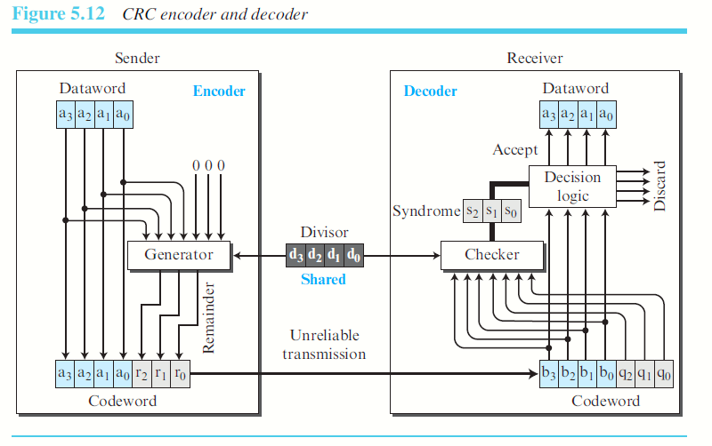
9.<number>

Slide 33
Dividend – is the dataword along with redundant bits.
Divisor – sender and receiver decide.
  Must include a min of bits.
  The MSB and LSB must be ‘1’. 1101 1001, 1011.
Quotient (not interested in CRC)
Remainder
CRC(7,4) – DIVISOR LENGTH WILL BE N-K+1 =4
CRC(N,K)- REDUNDNT BIT N-K = 3
9.<number>

Slide 34
DLL PROTOCOLS
HDLC – HIGH-LEVEL DATA LINK CONTROL PROTOCOL
PPP – POINT TO POINT PROTOCOL
  HDLC
A bit-oriented protocol for communication over point-to-point and multipoint links.
Configurations and Transfer Modes
Normal response mode (NRM).
Asynchronous balanced mode (ABM).
9.<number>

Slide 35
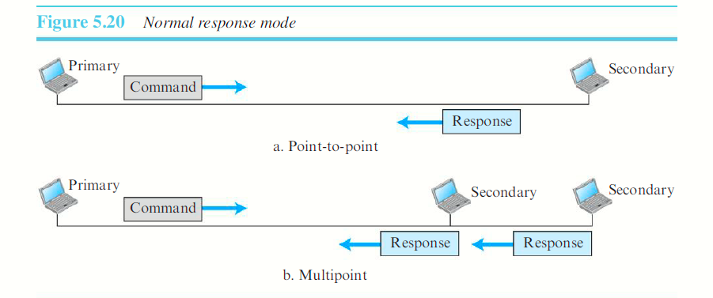
In Normal Response Mode, one primary station and multiple secondary stations.
A primary station can send commands; a secondary station can only respond.
The station configuration is unbalanced
9.<number>

Slide 36
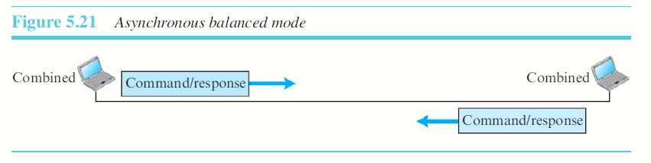
In Asynchronous Balanced Mode, The link is point-to-point, and each station can function as a primary and a secondary (acting as peers).
The configuration is balanced.

Slide 37
Frames
HDLC defines three types of frames:
  Information frames (I-frames)
  Supervisory frames (S-frames)
  Unnumbered frames (U-frames)
Each type of frame serves as an envelope for the transmission of a different type of message.
I-frames: used to transport user data and control information relating to user data (piggybacking).
S-frames: used only to transport control information.
U-frames: reserved for system management. (manages link)

Slide 38
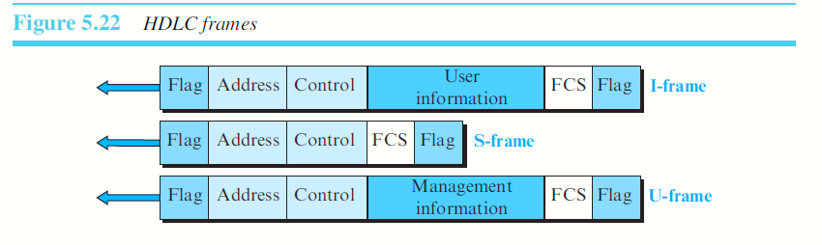
HDLC Frames
9.<number>

Slide 39
Flag field: This field contains synchronization pattern 01111110, which identifies both the beginning and the end of a frame.
Address field: This field contains the address of the secondary station.
  If a primary station created the frame, it contains a to address.
  If a secondary station creates the frame, it contains a from address. The address field can be one byte or several bytes long, depending on the needs of the network.
9.<number>

Slide 40
Control field: The control field is one or two bytes used for flow and error control.
Information field: The information field contains the user’s data from the network layer or management information.
  Its length can vary from one network to another.
FCS field: The frame check sequence (FCS) is the HDLC error detection field.
  It can contain either a 2- or 4-byte CRC.

Slide 41
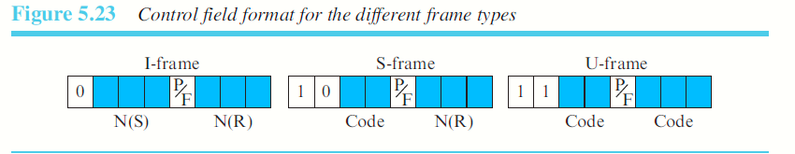
Control Field for I-Frames are designed to carry user data from the network layer.
They can include flow- and error-control information.
The subfields in the control field are used to define these functions. The first bit defines the type. If the first bit of the control field is 0, this means the frame is an I-frame. The next 3 bits, called N(S), define the sequence number of the frame.
3 bits, we can define a sequence number between 0 and 7. The last 3 bits, called N(R), correspond to the acknowledgment number when piggybacking is used. The single bit between N(S) and N(R) is called the P/F bit. The P/F field is a single bit with a dual purpose. It has meaning only when it is set (bit = 1) and can mean poll or final. It means poll when the frame is sent by a primary station to a secondary (when the address field contains the address of the receiver). It means final when the frame is sent by a secondary to a primary (when the address field contains the address of the sender).

Slide 42
Control Field for S-Frames Supervisory frames are used for flow and error control whenever piggybacking is either impossible or inappropriate. S-frames do not have information fields. If the first 2 bits of the control field are 10, this means the frame is an Sframe.
The last 3 bits, called N(R), corresponds to the acknowledgment number (ACK) or negative acknowledgment number (NAK) depending on the type of S-frame.

Slide 43
The 2 bits called code are used to define the type of S-frame itself.
Receive ready (RR): If the value of the code subfield is 00, it is an RR S-frame.
  This kind of frame acknowledges the receipt of a safe and sound frame or group of frames. In this case, the value of the N(R) field defines the acknowledgment number.
Receive not ready (RNR): If the value of the code subfield is 10, it is an RNR Sframe.
  It acknowledges the receipt of a frame or group of frames, and it announces that the receiver is busy and cannot receive more frames.
  It acts as a kind of congestion-control mechanism by asking the sender to slow down. The value of N(R) is the acknowledgment number.
Reject (REJ): If the value of the code subfield is 01, it is an REJ S-frame.
  It is a NAK used to improve the efficiency of the process by informing the sender, before the sender timer expires, that the last frame is lost or damaged. The value of N(R) is the negative acknowledgment number.
Selective reject (SREJ): If the value of the code subfield is 11, it is an SREJ Sframe.
  The HDLC Protocol uses the term selective reject instead of selective repeat. The value of N(R) is the negative acknowledgment number.

Slide 44
Control Field for U-Frames: Unnumbered frames are used to exchange session management and control information between connected devices.
As with S-frames, however, much of the information carried by U-frames is contained in codes included in the control field.
U-frame codes are divided into two sections:
  A 2-bit prefix before the P/F bit and a 3-bit suffix after the P/F bit. Together, these two segments (5 bits) can be used to create up to 32 different types of U-frames
9.<number>

Slide 45
PPP – POINT TO POINT PROTOCOL
Services Provided by PPP
PPP defines the format of the frame to be exchanged between devices.
It also defines how two devices can negotiate the establishment of the link and the exchange of data.
PPP is designed to accept payloads from several network layers (not only IP).
Authentication is also provided in the protocol.
The new version of PPP, called Multilink PPP, provides connections over multiple links.
It provides network address configuration.
9.<number>

Slide 46
Services Not Provided by PPP:
PPP does not provide flow control.
PPP has a very simple mechanism for error control. A CRC field is used to detect errors.
Lack of error control and sequence numbering may cause a packet to be received out of order.
PPP does not provide a sophisticated addressing mechanism
to handle frames in a multipoint configuration.

Slide 47
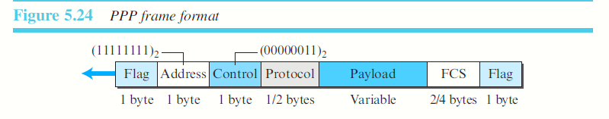
FRAMING: PPP uses a character-oriented (or byte-oriented) frame.
Flag: A PPP frame starts and ends with a 1-byte flag with the bit pattern 01111110.
Address: The address field in this protocol is a constant value and set to 11111111 (broadcast address).
Control: This field is set to the constant value 00000011 (imitating unnumbered frames in HDLC).
Protocol: The protocol field defines what is being carried in the data field: either user data or other information. This field is by default 2 bytes long, but the two parties can agree to use only 1 byte.
9.<number>

Slide 48
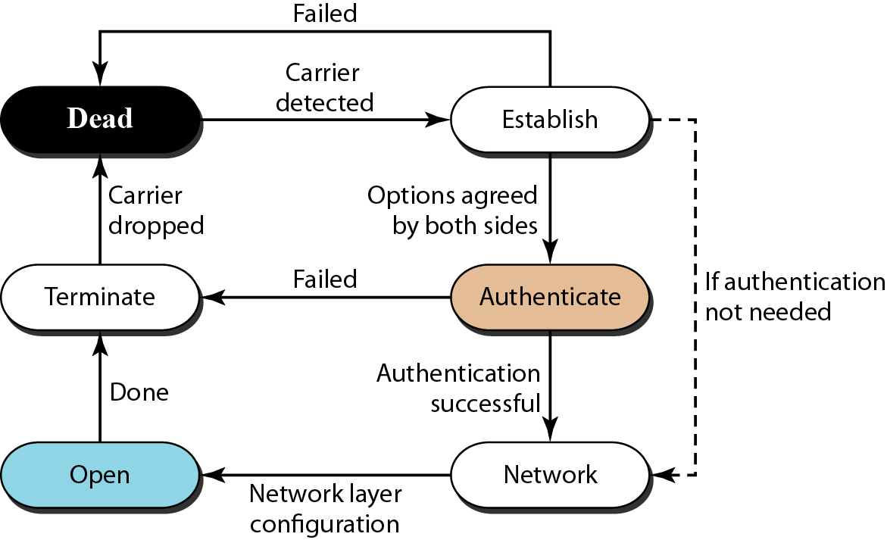
Figure 11.33 Transition phases
11.<number>

Slide 49
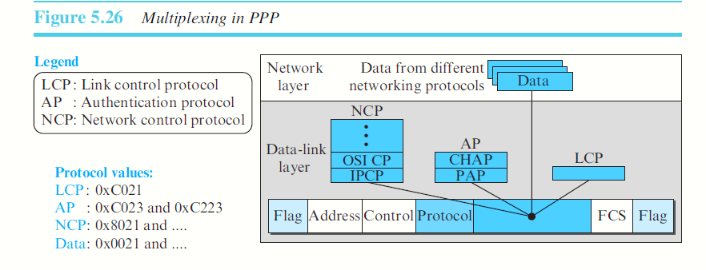
MULTIPLEXING:
PPP uses another set of protocols to establish the link, authenticate the parties involved, and carry the network-layer data.
Three sets:
  LCP (Link Control Protocol) -1
  AP (Authentication Protocols) - 2
  NCP (Network Control Protocol) - several
9.<number>

Slide 50
LCP
  responsible for establishing, maintaining, configuring, and terminating links.
  provides negotiation mechanisms to set options between the two endpoints.
AP –Authentication Protocol
  validating the identity of a user who needs to access a set of resources.
  PPP has created two protocols for authentication:
    Password Authentication Protocol (PAP)
    Challenge Handshake Authentication Protocol (CHAP)
9.<number>

Slide 51
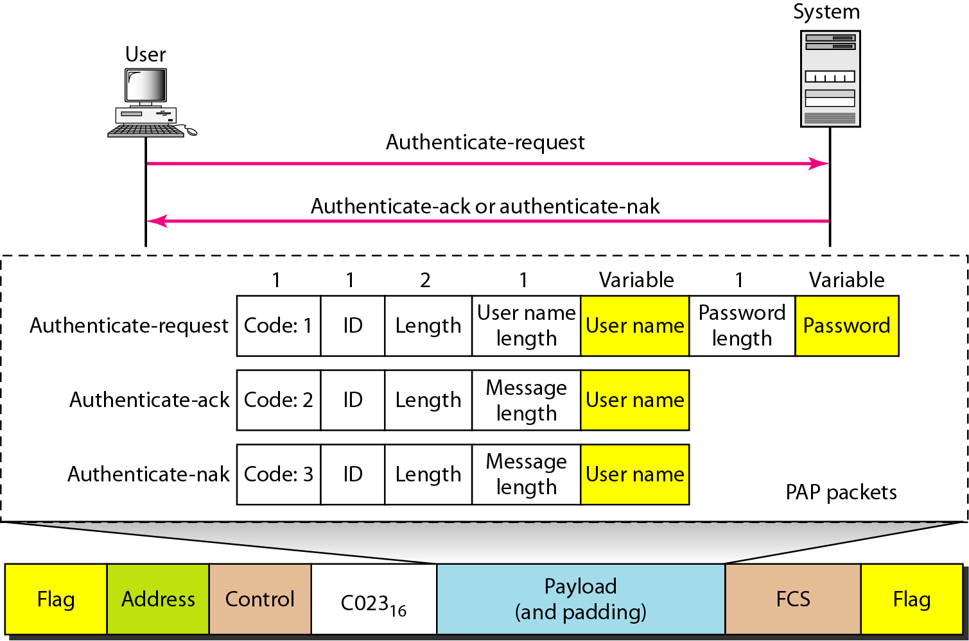
PAP : Two step process
  The user who wants to access a system sends an authentication identification (usually the user name) and a password.
  The system checks the validity of the identification and password and either accepts or denies connection.
9.<number>

Slide 52
CHAP: Three-way hand-shaking authentication protocol
  The system sends the user a challenge packet containing a challenge value, usually a few bytes.
  The user applies a predefined function that takes the challenge value and the user’s own password and creates a result. The user sends the result in the response packet to the system.
  The system does the same. It applies the same function to the password of the user (known to the system) and the challenge value to create a result. If the result created is the same as the result sent in the response packet, access is granted; otherwise, it is denied.
9.<number>

Slide 53
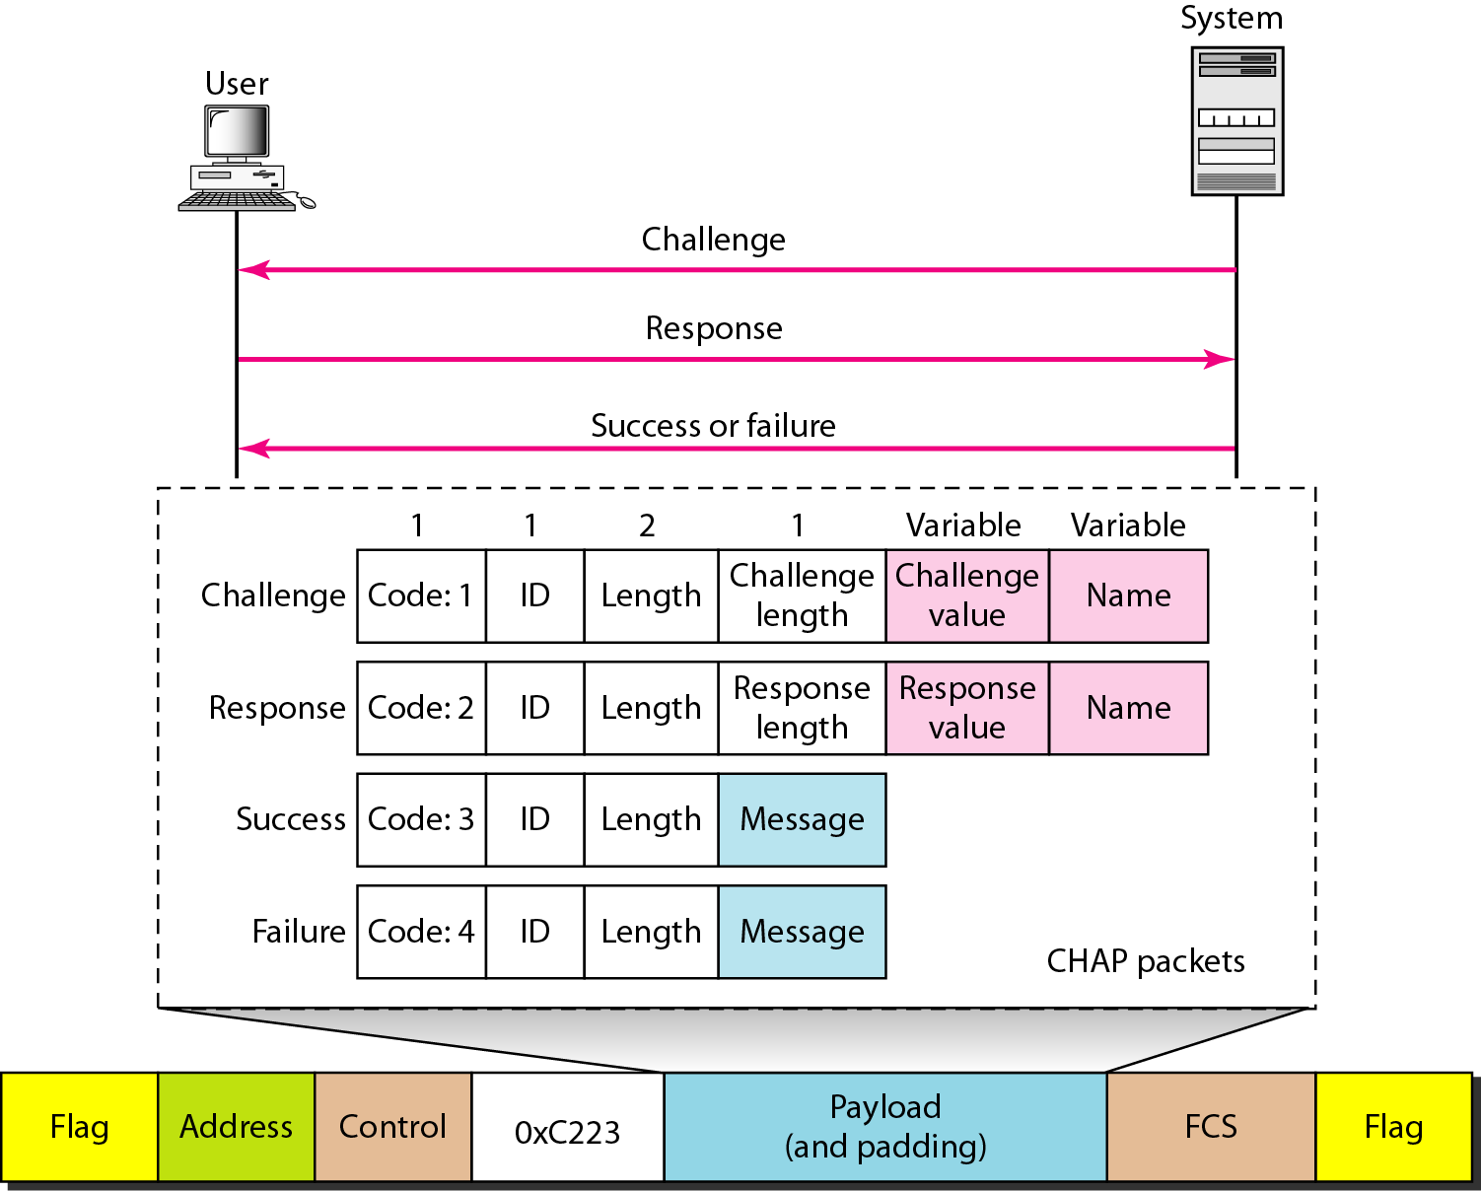
9.<number>

Slide 54
Network Control Protocols: PPP is a multiple-network-layer protocol. It can carry a network-layer data packet from protocols defined by the Internet, OSI, Xerox, DECnet, AppleTalk, Novel, and so on.
PPP has defined a specific Network Control Protocol for each network protocol. For example, Internet Protocol Control Protocol (IPCP) configures the link for carrying IP data packets. Xerox CP does the same for the Xerox protocol data packets, and so on. Note that none of the NCP packets carry network-layer data; they just configure the link at the network layer for the incoming data.
One NCP protocol is the Internet Protocol Control Protocol (IPCP). This protocol configures the link used to carry IP packets in the Internet. IPCP is especially of interest to us.
9.<number>

Slide 55
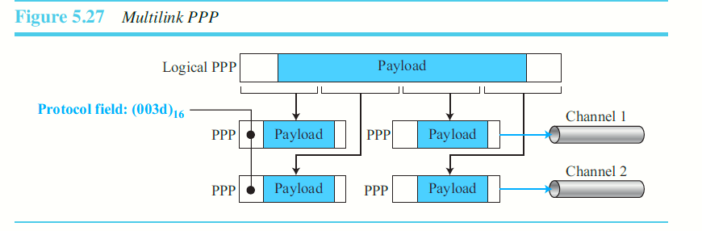
9.<number>

